Slide 1
Chapter 13 Global Register Allocation Via Graph Coloring

Slide 2
Structure of the Compiler’s Back End
Front End
Optimizer
Back End
source
code
IR
…
IR
target
code
Register use is critical to performance
Global register allocation attempts to make the best decisions for procedure
Spill choices
Register assignment
Problem is, of course, NP-Complete
Problem requires global analysis, global decisions, and local spill code insertion
Back End
Selection
Scheduling
Allocation
asm
∞
regs
asm
∞
regs
IR
∞
regs
asm
k
regs

Slide 3
Global Register Allocation
The Job
At each point in the code, determine which values live in registers
Select a PR for each such value
Critical Properties
Produce correct code that uses k or fewer registers
Minimize loads & stores used to spill & restore values
Minimize space to hold spilled values
Operate efficiently
O(n) to O(n²), but not O(2^{n})
Back End
Selection
Scheduling
Allocation
asm
∞
regs
asm
∞
regs
IR
∞
regs
asm
k
regs
PR ≅ physical register
k ≅ number of PRs
n ≅ number of operations

Slide 4
Global Register Allocation
Modern Global Allocators
Most global allocators operate via an analogy to graph coloring
Construct a “conflict graph” or “interference graph” that represents constraints on register co-occupancy
k-coloring ⇒ allocation to k PRs
What happens when the allocator does not find a k-coloring?
Spill some values, to create a nearby problem
Try again on that nearby problem
Back End
Selection
Scheduling
Allocation
asm
∞
regs
asm
∞
regs
IR
∞
regs
asm
k
regs
A k-coloring of a graph G is an assignment of k colors to the nodes of G such that no two adjacent nodes have the same color.
Typically, in a coloring problem, we favor smaller values of k over larger ones. In allocation, k is the number of available PRs.

Slide 5
What Makes Global Allocation Hard?
...
store r4 ⇒ x
load x ⇒ r1
...
What is harder across multiple blocks?
Could replace the load with a copy from r4
Good cross-block assignment would obviate the copy operation
Need a control-flow graph to understand the inter-block flow of values
Could do local allocation and “smooth out” these end-of-block effects
Might have a lot of adjusting to do at block boundaries

Slide 6
What Makes Global Allocation Hard?
...
store r4 ⇒ x
...
store r5 ⇒ x
Cannot easily extend the local algorithm to handle the global problems.
load x ⇒ r1
...
A more complex scenario
Block with multiple predecessors in the control-flow graph
Must get the “right” values in the “right” register in each predecessor
In a loop, a block can be its own predecessor
Multiple predecessors add complications to the problem
Coordinate allocation, assignment, & spilling in multiple blocks
With multiple successors, what does “farthest next use” even mean?
See Fischer & Proebsting, “Probabilistic Register Allocation”, PLDI ‘92.

Slide 7
What Makes Global Allocation Hard?
load r1 ⇒ r3
…
Cannot easily extend the local algorithm to handle the global problems.
…
add r3,r4 ⇒ r5
…
sub r2,r3 ⇒ r6
Another complex scenario
Block with multiple successors in the control-flow graph
What does “farthest next use” mean? (for local spill decisions)
See Fischer & Proebsting, “Probabilistic Register Allocation,” in PLDI ‘92
Local allocation, which was simple in isolation, requires global analysis in the context of surrounding code
(And we ignored the issue of matching up the allocations across blocks)

Slide 8
Global Register Allocation
Taking a global approach
Abandon the distinction between local and global
Make systematic use of registers and spill locations
Adopt a general scheme to approximate good allocation
Graph-coloring paradigm
Build an interference graph G for the procedure
(try to) construct a k-coloring for G
Minimal coloring is NP-Complete
Spill placement becomes a critical performance issue
Move spills to infrequently executed places?
Map colors into physical registers

Slide 9
Graph Coloring
The Problem
A graph G is said to be k-colorable if and only if the nodes can be labeled with integers from 1 to k such that no edge in G connects two nodes with the same label. The labels are referred to as “colors”.
Examples
Each color can be mapped to a distinct physical register.
2-colorable
3-colorable

Slide 10
Graph Coloring Register Allocation
4 major aspects:
Constructing global live ranges
not the same as intuitive live range in straight-line code
Building interference graph for a procedure captures information about overlapping live ranges
Estimating spill costs important to consider when k-coloring fails
(Try to) construct a k-coloring
if unsuccesful,
choose values to spill and repeat
spill placement becomes critical issue

Slide 11
Live range
A live range consists of a set of definitions and uses that
for any use in the set, all definitions that reach it are in the set too
for any definitions in the set, all uses it reaches are in the set too
Fundamental Invariant: All references in a live range are allocated to the same physical register.

Slide 12
Discovering Global Live Ranges
Information needed to compute live ranges: need all definitions that reach a single use, and vice versa
SSA (Static Single Assignment )form provides exactly this information:
each SSA variable has a single definition and zero or more uses
φ-functions show multiple definitions that reach a use

Slide 13
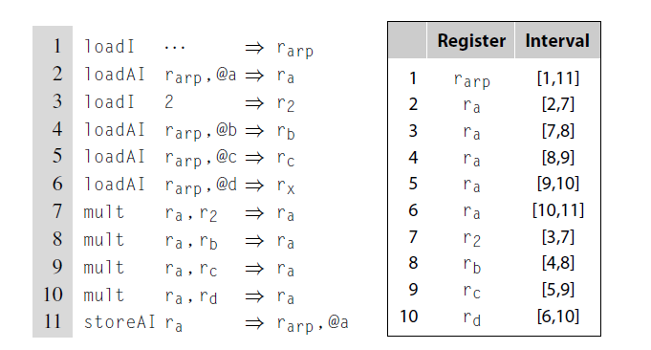
Live Ranges
Live Ranges in a single block
r_{d}

Slide 14
Live Ranges
B₀
x ← …
z ← …
In the multi-block case, live ranges are more complex than in the local case.
Consider x, y, & z in the code to the right
B₁
y ← …
B₂
x ← y
y ← x
x ← …
B₃
… ← y
y ← z
B₄
… ← …
z ← …
B₅
… ← x + y + z

Slide 15
Live Ranges
In the multi-block case, live ranges are more complex than in the local case.
Consider x, y, & z in the code to the right
x has 2 distinct live ranges
B₀
x ← …
z ← …
B₁
y ← …
B₂
x ← y
y ← x
x ← …
B₃
… ← y
y ← z
B₄
… ← …
z ← …
B₅
… ← x + y + z

Slide 16
Live Ranges
In the multi-block case, live ranges are more complex than in the local case.
Consider x, y, & z in the code to the right
x has 2 distinct live ranges
y has 2 distinct live ranges
B₀
x ← …
z ← …
B₁
y ← …
B₂
x ← y
y ← x
x ← …
B₃
… ← y
y ← z
B₄
… ← …
z ← …
B₅
… ← x + y + z

Slide 17
Live Ranges
In the multi-block case, live ranges are more complex than in the local case.
Consider x, y, & z in the code to the right
x has 2 distinct live ranges
y has 2 distinct live ranges
z has just 1 live range
The 2 defs must be in the same LR so that the use in B₃ has 1 name for them
z is never live in B₂
Finding live ranges in the global context takes global analysis
B₀
x ← …
z ← …
B₁
y ← …
B₂
x ← y
y ← x
x ← …
B₃
… ← y
y ← z
B₄
… ← …
z ← …
B₅
… ← x + y + z

Slide 18
Rename Live Ranges
The allocator systematically renames values into live ranges
Creates a new name for each definition point, and propagates those names forward to uses
Classic global data-flow analysis problem: reaching definitions
Annotates each node with a set of reaching uses that the compiler can interpret in a fashion similar to the dependence graph edges in scheduling
At each use, union together all the def names that reach the use
At each def, union together all of the use names that the def can reach
Creates a web of definitions and uses that are interconnected
These webs are global live ranges
Rename the code so that each global live range has a unique name

Slide 19
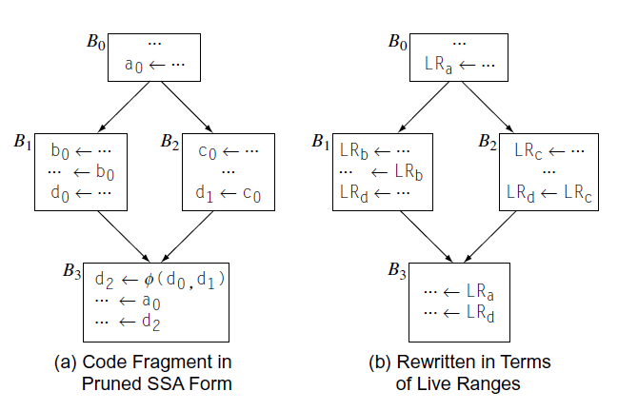
Rename Live Ranges
LRa = {a₀}
LRb = {b₀}
LRc = {c₀}
LRd = {d₀ , d₁ , d₂}
Treat all references in the same live range as a single virtual register

Slide 20
Graph Coloring Register Allocation
4 major aspects:
Constructing global live ranges
not the same as intuitive live range in straight-line code
Building interference graph for a procedure captures information about overlapping live ranges
Estimating spill costs important to consider when k-coloring fails
(Try to) construct a k-coloring
if unsuccesful,
choose values to spill and repeat
spill placement becomes critical issue

Slide 21
Build the Interference Graph
What is an interference? (or conflict)
Two values interfere if they cannot occupy the same register
x and y interfere if there exists an operation where both are live
If x and y interfere, they cannot occupy the same register
Unless the compiled code plays bizarre tricks using XOR or the like
Or, the compiler can prove that x and y always have the same value in the region where they interfere. (See “copy coalescing”)
The compiler captures the conflict relationship in an interference graph
Nodes in G represent values, or live ranges
Edges in G represent individual interferences
For x & y, <x,y> ∈ G iff x & y interfere
A k-coloring of G can be mapped into an allocation to k registers

Slide 22
Build the Interference Graph
Pay attention to this exception
Standard updates for local LIVE computation
To construct the graph
Compute LIVEOUT sets over live range names
Use the equations & iterative solver from previous lecture
Renaming already rewrote the code into live range names
Iterate over each block, bottom to top
Track the current LIVE set
At each operation, except a register-to-register copy operation,
Add an edge from the defined live range to each live range in LIVE
Remove the defined live range from LIVE
Add the used live ranges to LIVE
Data structures are important
Algorithm needs to test for edge membership in the graph
Algorithm needs to iterate over edges
Needs both a bit-matrix & adjacency lists (upper diagonal bit matrix)

Slide 23
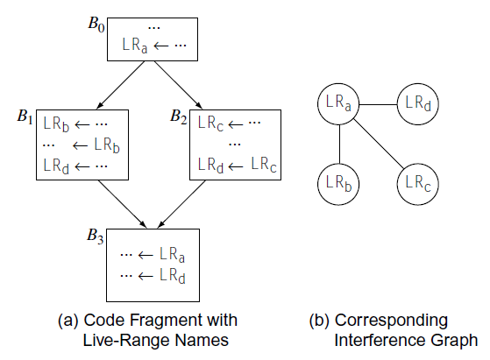
Build the Interference Graph

Slide 24
Graph Coloring Register Allocation
4 major aspects:
Constructing global live ranges
not the same as intuitive live range in straight-line code
Building interference graph for a procedure captures information about overlapping live ranges
Estimating spill costs important to consider when k-coloring fails
(Try to) construct a k-coloring
if unsuccesful,
choose values to spill and repeat
spill placement becomes critical issue

Slide 25
Computing Spill Costs
The allocator needs a spill-cost estimate for each LR to guide spill choice
Accurate estimates lead to better spill decisions (we hope)
Compute estimated spill cost for a specific LR as
the sum over all defs in an LR of frequency x cost(store) plus
the sum over all uses in an LR of frequency x cost(load)
frequency is estimated as 10^{d} where d is the loop nesting depth of the reference to the LR
Multiple sharp corner cases
Some live ranges have infinite spill costs
No value dies during the live range
Caveat: > k-1 infinite spill cost LRs together is a problem (code shape?)
Multiple restores in a low-demand block & other similar local issues

Slide 26
Graph Coloring Register Allocation
4 major aspects:
Constructing global live ranges
not the same as intuitive live range in straight-line code
Building interference graph for a procedure captures information about overlapping live ranges
Estimating spill costs important to consider when k-coloring fails
(Try to) construct a k-coloring
if unsuccesful,
choose values to spill and repeat
spill placement becomes critical issue

Slide 27
Coloring the Graph
The heart of a graph-coloring allocator is the coloring algorithm
The coloring algorithm operates by carefully ordering the nodes & then attempting to color the nodes in that order
Key Observation
Any node that has fewer than k neighbors in the interference graph can always be colored
If a node has at least k neighbors: Neighbors may still use fewer than k distinct colors ⇒ defer spilling until you are sure it is needed
Idea: Simplify the graph
Compute an order that colors the most constrained nodes first
Following the order, assign colors
If some nodes fail to color, spill their live ranges and try again
Spilled live range becomes a collection of small ones around defs & uses

Slide 28
Coloring the Graph
Algorithm //Use stack of nodes
while there are still nodes in the graph
if ∃ node n with < k neighbors
push n on stack
else
pick n as possible spill candidate and push n on stack
remove n & its edges
while stack is non-empty
pop n
re-insert n & its edges
try to color n
if fail to color
leave n uncolored

Slide 29
Picking a Spill Candidate
When ∀ n ∈ G, n° ≥ k, Simplify must pick a spill candidate
Chaitin’s Heuristic
Minimize spill cost ÷ current degree
If x has a negative spill cost, spill it pre-emptively
Cheaper to spill it than to keep it in a register
If x has an infinite spill cost, it cannot be spilled
No LR dies between x’s definition and its use
No more than k definitions since last value died (code shape safety valve)
cand ← LR₀
for 1 < i ≤ n
if (cost(cand) / degree(cand)
> cost(LR_{i}) / degree(LR_{i}) )
then cand ← LR_{i}
spill cand

Slide 30
Structure of a Chaitin-Briggs Allocator
Names from optimizer
Live range names
renumber
Build SSA, build live ranges, rename
build
Build the interference graph
coalesce
Fold unneeded copies
LR_{x}→ LR_{y}, and <LR_{x},LR_{y}> ∉ G_{I} ⇒ combine LR_{x} & LR_{y}
Any copies coalesced?
spill costs
Estimate cost for spilling
each live range
while N is non-empty
if ∃ n with n°< k then
push n onto stack
else pick n to spill
push n onto stack
remove n from G_{I}
simplify
Remove nodes from the graph
select
While stack is non-empty
pop n, insert n into G_{I}, & try to color it
Any uncolored live ranges?
spill
Spill uncolored definitions & uses
Rewrite VRs with PRs

Slide 31
Spill
Spill inserts spill code for any uncolored register
Chaitin-Briggs allocators spill entire live ranges
Insert a load before each use in the spilled LR
Insert a store after each def in the spilled LR
Converts a single LR into multiple tiny LRs with infinite spill cost
This philosophy ensures that the “big loop” halts
If necessary, the code will devolve down to all tiny LRs & need few colors
As long as target machine has enough registers to hold operands for its most demanding operation, it will color
In practice, it will color long before that point — say 2 to 4 iterations
“Spill everywhere” is a weakness of allocators like Chaitin-Briggs
Leads to spilling in areas of low pressure
Provoked work on live-range splitting (another truly hard problem)

Slide 32
Example of Chaitin-Briggs Coloring
Assume k = 3
2
1
4
5
3
Stack
1 is the only node with degree < 3

Slide 33
Example of Chaitin-Briggs Coloring
Assume k = 3
2
4
5
3
1
Stack
Now, 2 & 3 have degree < 3

Slide 34
Example of Chaitin-Briggs Coloring
Assume k = 3
4
5
3
2
1
Stack
Now all nodes have degree < 3

Slide 35
Example of Chaitin-Briggs Coloring
Assume k = 3
5
4
3
2
1
Stack

Slide 36
Example of Chaitin-Briggs Coloring
Assume k = 3
Colors:
1:
5
3
2:
4
2
3:
1
Stack

Slide 37
Example of Chaitin-Briggs Coloring
Assume k = 3
Colors:
1:
5
3
2:
4
2
3:
1
Stack

Slide 38
Example of Chaitin-Briggs Coloring
Assume k = 3
Colors:
1:
5
2:
4
3
2
3:
1
Stack

Slide 39
Example of Chaitin-Briggs Coloring
Assume k = 3
Colors:
1:
4
5
2:
3
2
3:
1
Stack

Slide 40
Example of Chaitin-Briggs Coloring
Assume k = 3
Colors:
2
1:
4
5
2:
3
3:
1
Stack

Slide 41
Example of Chaitin-Briggs Coloring
Assume k = 3
Colors:
2
1:
1
4
5
2:
3
3:
Stack

Slide 42
Chaitin-Briggs in Practice
2 Registers
2
1
4
3
Stack
No node has degree < 2, do we need to spill a node?

Slide 43
Chaitin-Briggs in Practice
2 Registers
2
1
4
3
Stack
Pick a node, say 1

Slide 44
Chaitin-Briggs in Practice
2 Registers
2
4
3
1
Stack
Pick a node, say 1

Slide 45
Chaitin-Briggs in Practice
2 Registers
2
4
3
1
Stack
Now, both 2 & 3 have degree < 2
Pick one, say 3

Slide 46
Chaitin-Briggs in Practice
2 Registers
2
4
3
1
Stack
Both 2 & 4 have degree < 2.
Take them in order 2, then 4.

Slide 47
Chaitin-Briggs in Practice
2 Registers
4
2
3
1
Stack

Slide 48
Chaitin-Briggs in Practice
2 Registers
4
2
3
1
Stack
Now, rebuild the graph

Slide 49
Chaitin-Briggs in Practice
2 Registers
Colors:
1:
4
2:
2
3
1
Stack

Slide 50
Chaitin-Briggs in Practice
2 Registers
Colors:
2
1:
4
2:
3
1
Stack

Slide 51
Chaitin-Briggs in Practice
2 Registers
Colors:
2
1:
4
2:
3
1
Stack

Slide 52
Chaitin-Briggs in Practice
2 Registers
Colors:
2
1:
1
4
2:
3
Stack

Slide 53
Summary: Chaitin-Briggs Allocator
Rename Live Ranges
Find live ranges, rename, compute LIVE
Build the interference graph, G
Fold unneeded copies
x → y & (x,y) ∉ G ⇒ coalesce x & y
Estimate spill cost for each live range
Remove nodes from G
While stack is non-empty
pop n, insert n into G, & try to color n
Spill any uncolored definitions & uses
Build Graph
Coalesce Copies
Compute Spill Costs
Simplify Graph
Select Colors
Spill

